Slide 1
Co-rdinator Election Algorithms
George Coulouris, Jean Dollimore and Tim Kindberg, “Distributed Systems Concepts and Design”, Fifth Edition, Pearson Education, 2012
Notes:
1

Slide 2
Election Introduction
An algorithm for choosing a unique process to play a particular role is called an Election Algorithm.
It is essential that all the processes agree on the choice. Afterwards, if the process that plays the role of server wishes to retire then another election is required to choose a replacement.
An individual process does not call more than one election at a time, but in principle the N processes could call N concurrent elections
A process pi is
either a participant –it is engaged in some run of the election algorithm.
or a non-participant –it is not currently engaged in any election

Slide 3
Election Introduction
Important requirement is for the choice of elected process to be unique, even if several processes call elections concurrently.
For instance, two processes could decide independently that a coordinator process has failed, and both call elections.
We require that the elected process be chosen as the one with the largest identifier.
Each process pi ( i = 1, 2,…N ) has a variable electedi= ⊥, which will contain the
identifier of the elected process
E1: (safety) A participant process pi has electedi = ⊥ or electedi = P, where P is chosen as the non-crashed process at the end of the run with the largest identifier.
E2: (liveness) All processes pi participate and eventually either set electedi = ⊥ – or crash.
Performance of an election algorithm by its total network bandwidth utilization and by the turnaround time for the algorithm

Slide 4
Election Algorithms
Ring-based Election Algorithm
Bully Algorithm

Slide 5
Election Algorithms
Ring-based Election Algorithm

Slide 6
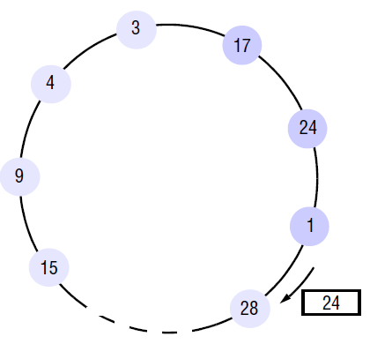
Ring-based Election Algorithm
The algorithm of Chang and Roberts [1979] is suitable for a collection of processes arranged in a logical ring.
Each process pi has a communication channel to the next process in the ring, p(i + 1)mod N , and all messages are sent clockwise around the ring
It assume that no failures occur, and that the system is asynchronous
The goal of this algorithm is to elect a single process called the coordinator, which is the process with the largest identifier

Slide 7
Ring-based Election Algorithm
Initially, every process is marked as a non-participant in an election.
Any process can begin an election. It proceeds by marking itself as a participant, placing its identifier in an election message and sending it to its clockwise neighbor.
When a process receives an election message, it compares the identifier in the message with its own.
If the arrived identifier is greater, then it forwards the message to its neighbor.
If the arrived identifier is smaller and the receiver is not a participant, then it substitutes its own identifier in the message and forwards it;
On forwarding an election message in any case, the process marks itself as a participant
If, however, the received identifier is that of the receiver itself, then this process’s identifier must be the greatest, and it becomes the coordinator. The coordinator marks itself as a non-participant once more and sends an elected message to its neighbor, announcing its election and enclosing its identity

Slide 8
Ring-based Election Algorithm
When a process pi receives an elected message, it marks itself as a nonparticipant, sets its variable electedi to the identifier in the message and, unless it is the new coordinator, forwards the message to its neighbour.
Condition E1 is met. All identifiers are compared, since a process must receive its own identifier back before sending an elected message.
For any two processes, the one with the larger identifier will not pass on the other’s identifier. It is therefore impossible that both receive their own identifier back.
Condition E2 follows immediately from the guaranteed traversals of the ring (there are no failures).

Slide 9
Ring-based Election Algorithm
The worst-performing case is when its anti-clockwise neighbour has the highest identifier.
A total of N – 1 messages are then required to reach this neighbour.
It will not announce its election until its identifier has completed another circuit, taking a further N messages.
The elected message is then sent N times,
Making 3N – 1 messages in all.
The turnaround time is also 3N – 1 , since these messages are sent sequentially.
Drawback
It does not tolerate failures making it limited practical value.
Reliable failure detector is required for process crashes

Slide 10
Election Algorithms
Bully Algorithm

Slide 11
Bully Algorithm
The bully algorithm [Garcia-Molina 1982] allows processes to crash during an election, although it assumes that message delivery between processes is reliable.
This algorithm assumes that the system is synchronous: it uses timeouts to detect a process failure
In Bully algorithm : Each process knows which processes have higher identifiers, and that it can communicate with all such processes. 3 message types.
Election message is sent to announce an election;
Answer message is sent in response to an election message and
Coordinator message is sent to announce the identity of the elected process

Slide 12
Bully Algorithm
A process begins an election when it notices, through timeouts, that the coordinator has failed.
Several processes may discover this concurrently.
Maximum message transmission delay, Ttrans , and a maximum delay for processing a message Tprocess .
Time T = 2Ttrans + Tprocess that is an upper bound on the time that can elapse between sending a message to another process and receiving a response.
If no response arrives within time T, recipient of request has failed.

Slide 13
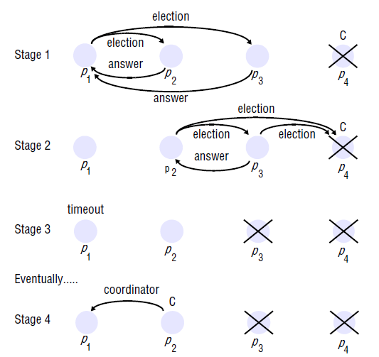
Bully Algorithm

Slide 14
Bully Algorithm
The process that knows it has the highest identifier can elect itself as the coordinator simply by sending a coordinator message to all processes with lower identifiers.
On the other hand, a process with a lower identifier can begin an election by sending an election message to those processes that have a higher identifier and awaiting answer messages in response.
If none arrives within time T, the process considers itself the coordinator and sends a coordinator message to all processes with lower identifiers announcing this.
If a process pi receives a coordinator message, it sets its variable electedi to the identifier of the coordinator
If a process receives an election message, it sends back an answer message and begins another election

Slide 15
Bully Example
1
4
3
3, 4 respond
0
2
1
5
4
3
2 calls election
0
2
5

Slide 16
Bully Example, continued
1
4
3
4 calls election
0
2
1
5
4
3
3 calls election
0
2
5

Slide 17
Bully Example, concluded
1
4
3
4 is the new leader
0
2
1
5
4
3
4 responds to 3
0
2
5

Slide 18
Bully Algorithm
Algorithm clearly meets the liveness condition E2, by the assumption of reliable message delivery.
Algorithm is not guaranteed to meet the safety condition E1 if processes that have crashed are replaced by processes with the same identifiers.
A process that replaces a crashed process p may decide that it has the highest identifier just as another process (which has detected p’s crash) decides that it has the highest identifier.
Two processes will therefore announce themselves as the coordinator concurrently.
That is why this algorithm is called Bully Algorithm

Slide 19
Bully Algorithm
Performance of the algorithm, in the best case the process with the second-highest identifier notices the coordinator’s failure.
Then it can immediately elect itself and send N – 2 coordinator messages. The turnaround time is one message.
The bully algorithm requires O (N^2) messages in the worst case – that is, when the process with the lowest identifier first detects the coordinator’s failure.
For then N – 1 processes altogether begin elections, each sending messages to processes with higher identifiers.

Slide 20
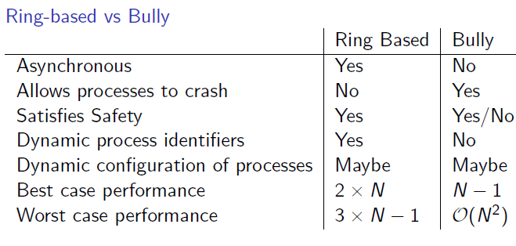
Summary

Slide 21
Summary
Electing process with highest identifier as a co-ordinator process.
Ring-based election algorithm
Bully Algorithm

